Slide 1
Adventures with the Poisson distribution: on simplicity and reproducibility in microbial analyses.
Anthony Fodor
UNC Charlotte
Bioinformatics and Genomics

Slide 2

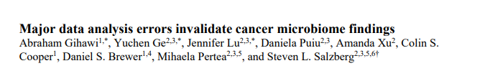
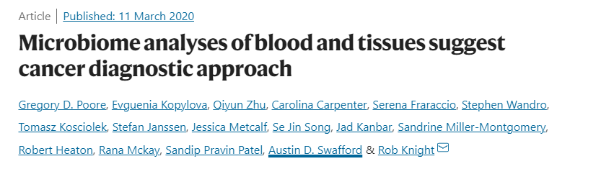
The interpretation of metagenomics experiments in complicated…
https://www.nytimes.com/2023/08/25/health/cancer-microbes-debate.html

Slide 3
Why are microbiome experiments hard?
Effect sizes (experimental signals) are often small
Low abundance microbes are hard to detect
Batch effect can dominate

Slide 4
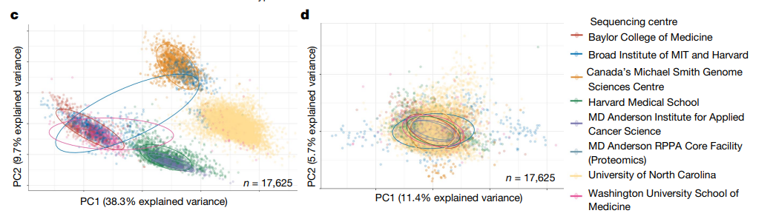
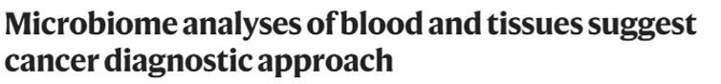
Batch effects are reliably the strongest signal in microbiome data
Attempts to correct these batch effects are a major source of the current controversies

Slide 5

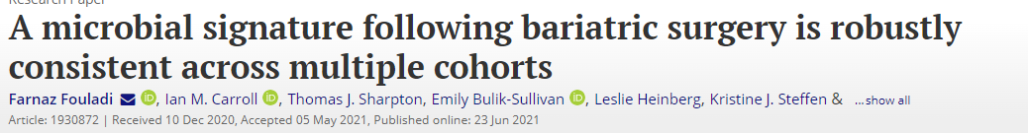
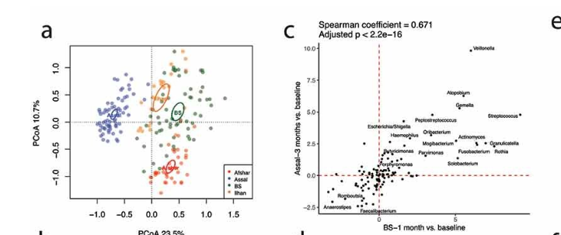


Sometimes working in inference space can allow for interpretation of similarities across batches
(rather than trying to normalize differences away)
Kristine Steffen
Leslie Heinberg
Farnaz Fouladi

Slide 6
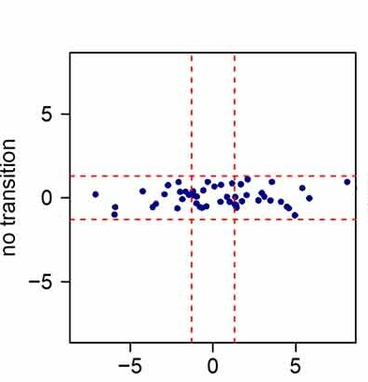
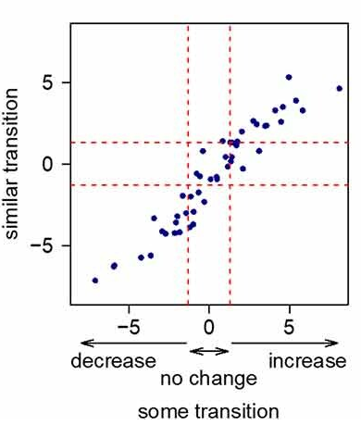
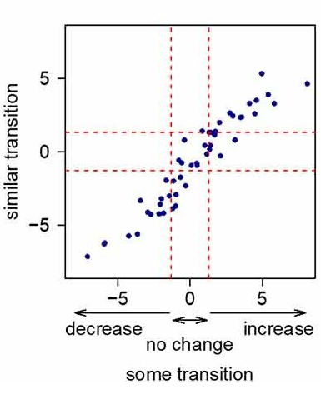
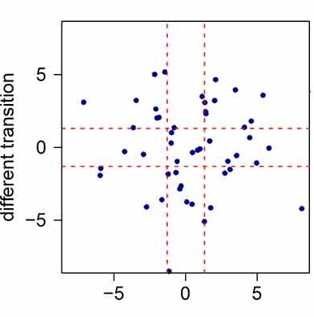

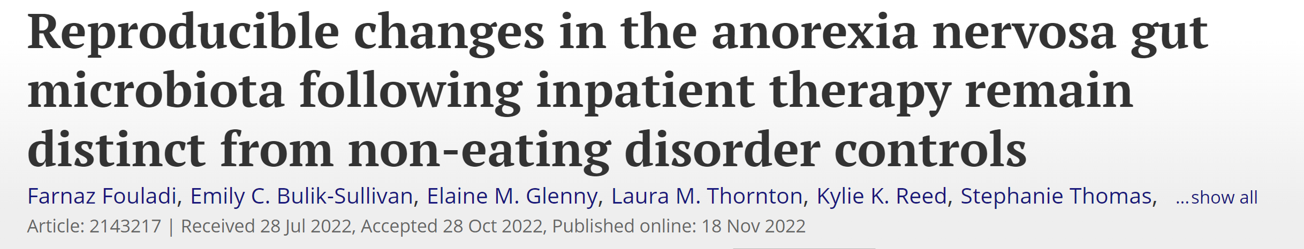
P-value vs. p-value plots examine an expectation of common inference from two pipelines
Ivory Blakley

Slide 7

We can examine expectation of common inference across difference cohorts in the same study
Farnaz Fouladi
Ian Carroll

Slide 8
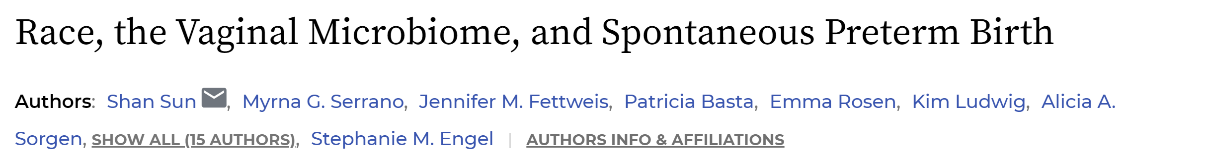

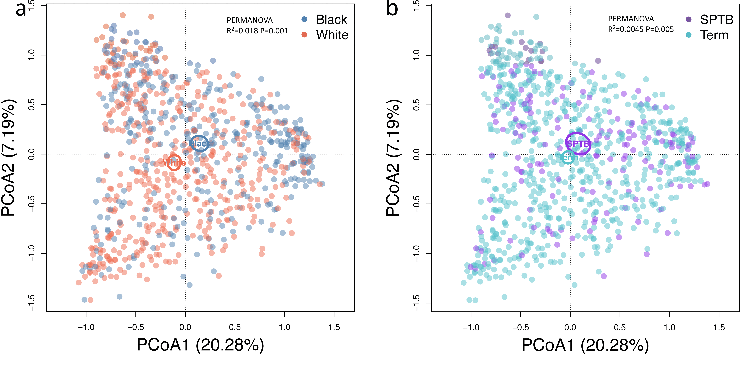


Shan Sun
Alicia Sorgen
Stephanie Engel

Slide 9
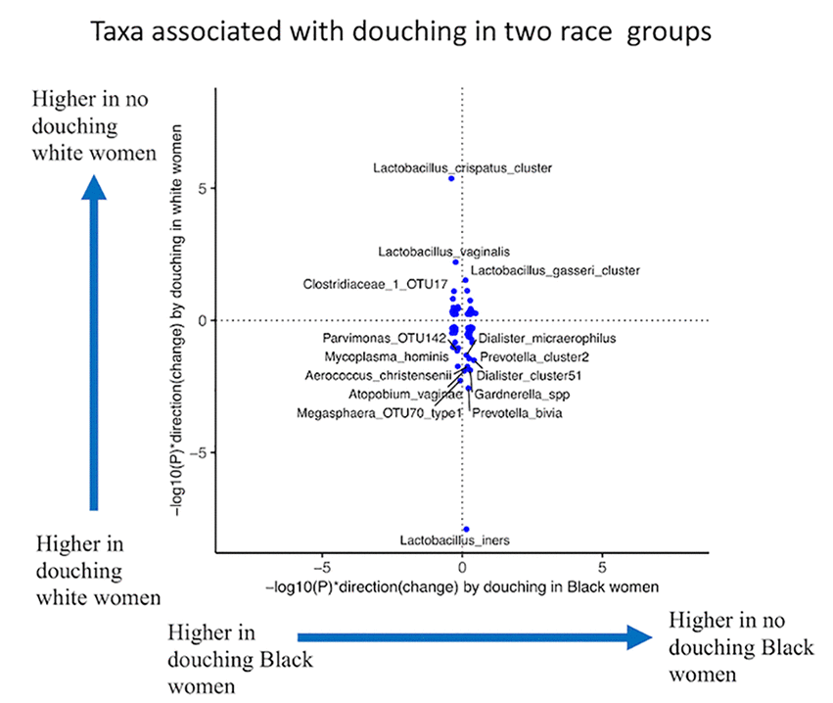
Different study populations can yield opposite results from microbiome association studies
Shan Sun
Alicia Sorgen
Stephanie Engel

Slide 10
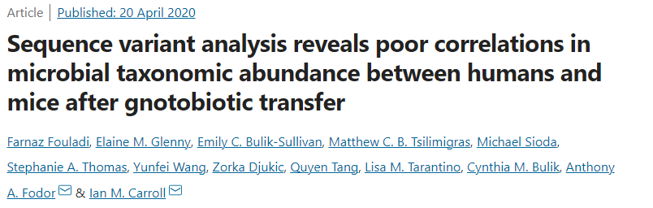
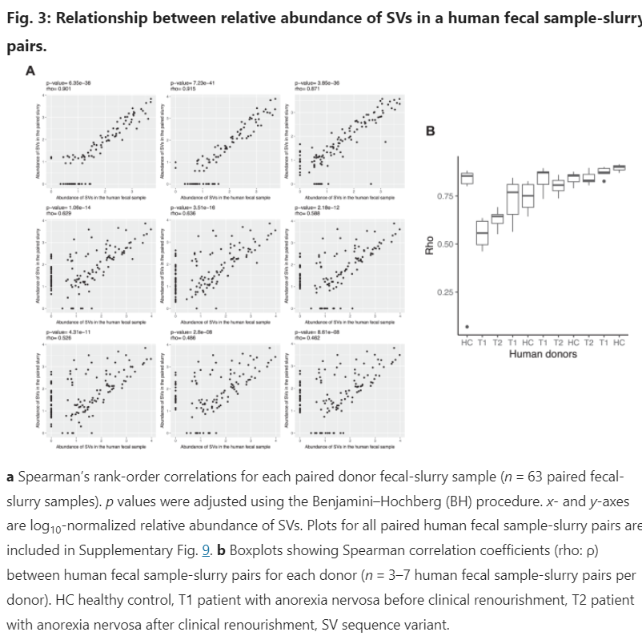
Human fecal samples retain their signal in a “test-tube” slurry…
Farnaz Fouladi
Ian Carroll

Slide 11
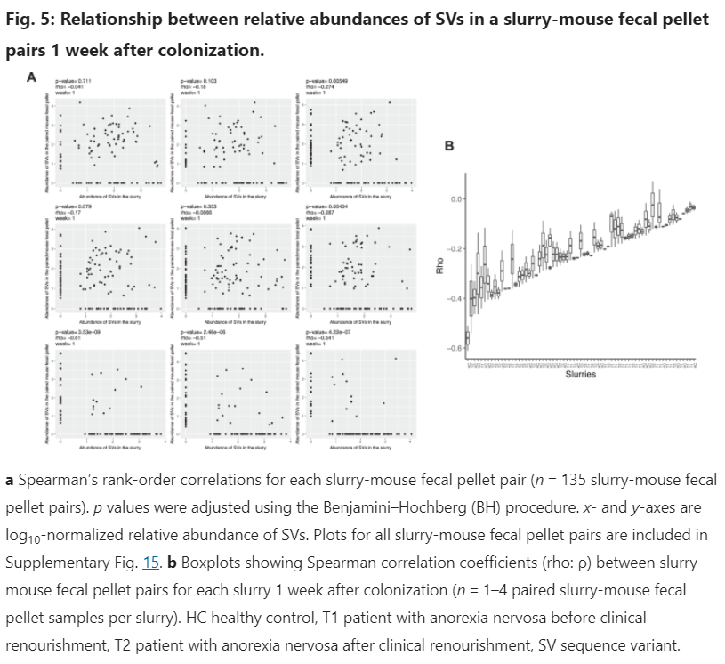
But between human and mouse gut, there is essentially no correlation
Farnaz Fouladi
Ian Carroll

Slide 12

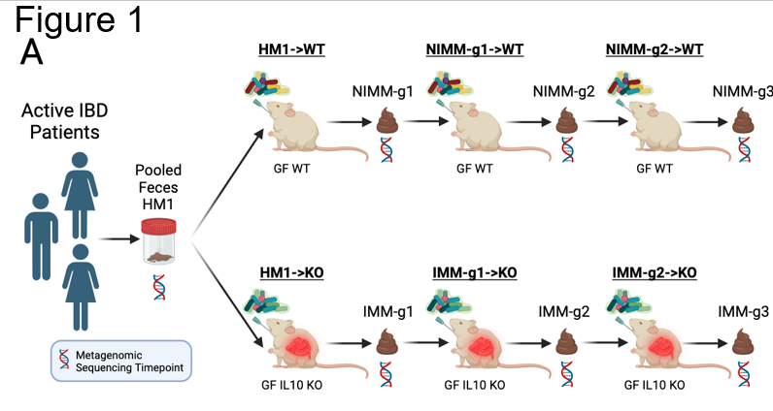


What are the consequences of human to mouse variability for phenotype?
Anh Moss
Simon Gray
R. Balfour Sartor

Slide 13
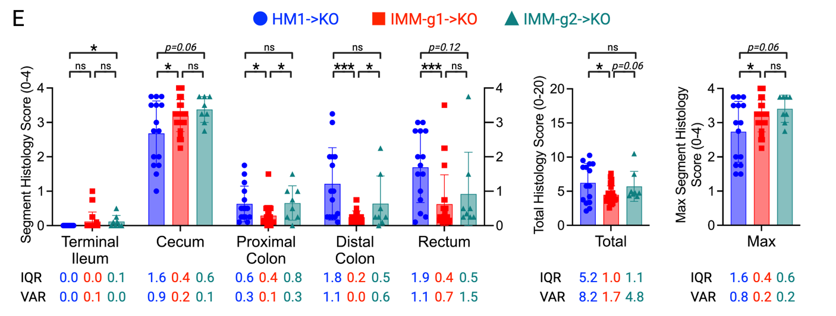
Mouse to mouse transfer maintains an inflammation phenotype but with lower variance

Slide 14
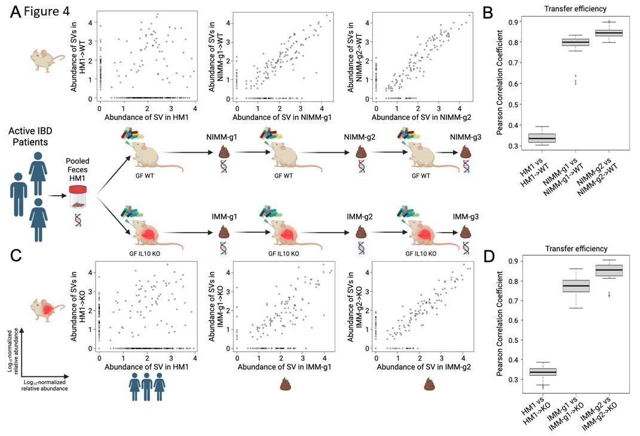
Mouse to mouse transfer maintains the microbial community through serial transfers

Slide 15
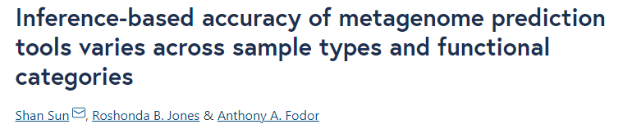
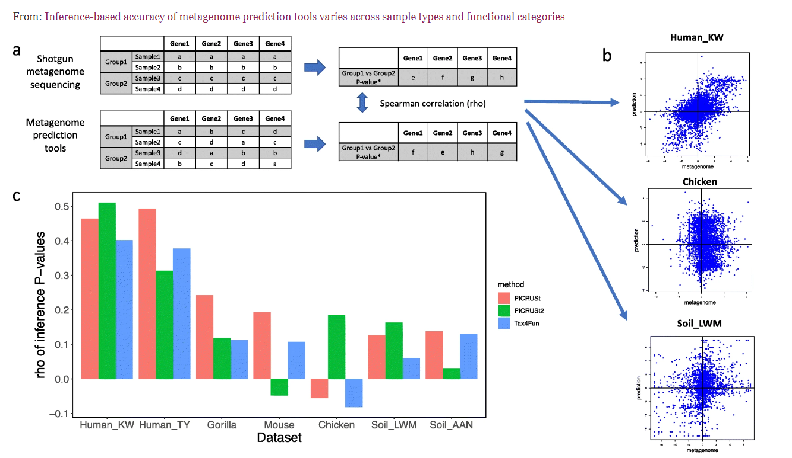

Inference (p-value vs. p-value) plots also allow us to compare different informatics pipelines
Shan Sun
Roshanda Jones

Slide 16

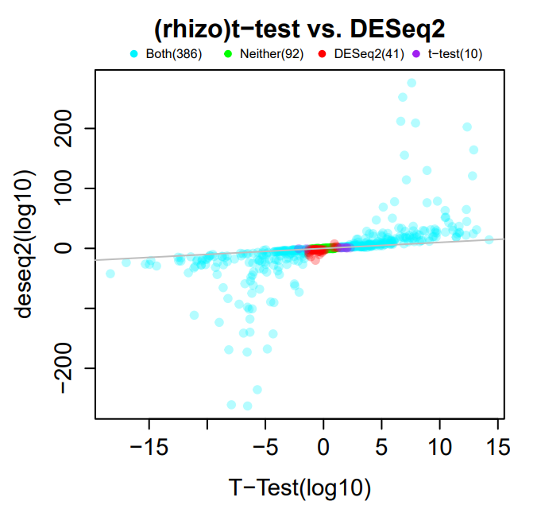
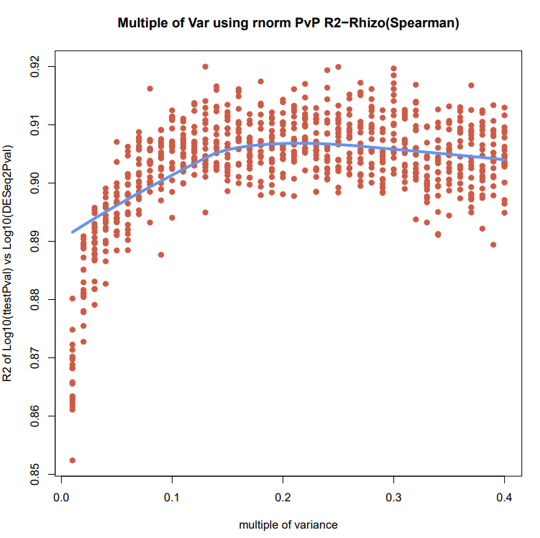
Inference (p-value vs. p-value) plots also allow us to compare different informatics pipelines
Here we see that DeSeq2 is very similar to the t-test (with reduced variance)
Ke Zeng
Re-calculate t-test artificially lowering the variance through resampling

Slide 17
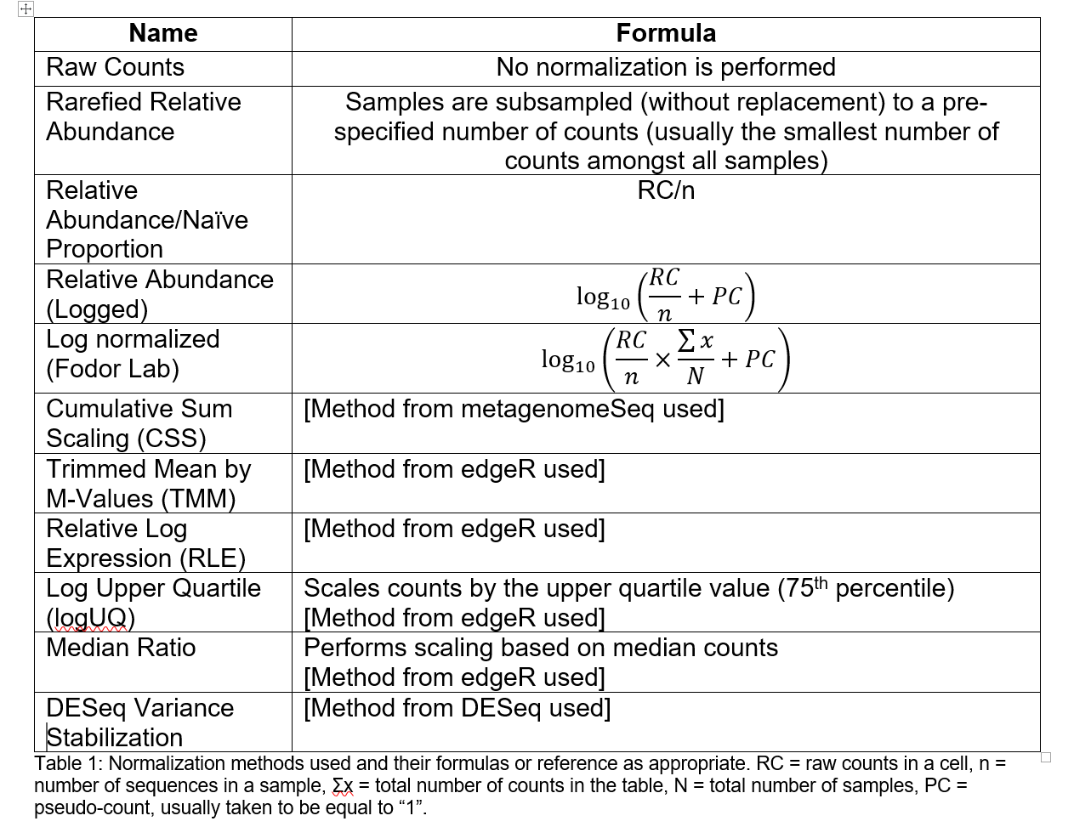
There are numerous normalization choices (within and across studies) that we face in our pipelines..
Table due to :Matthew C. B. Tsilimigras (Matthew C. Brown)

Slide 18
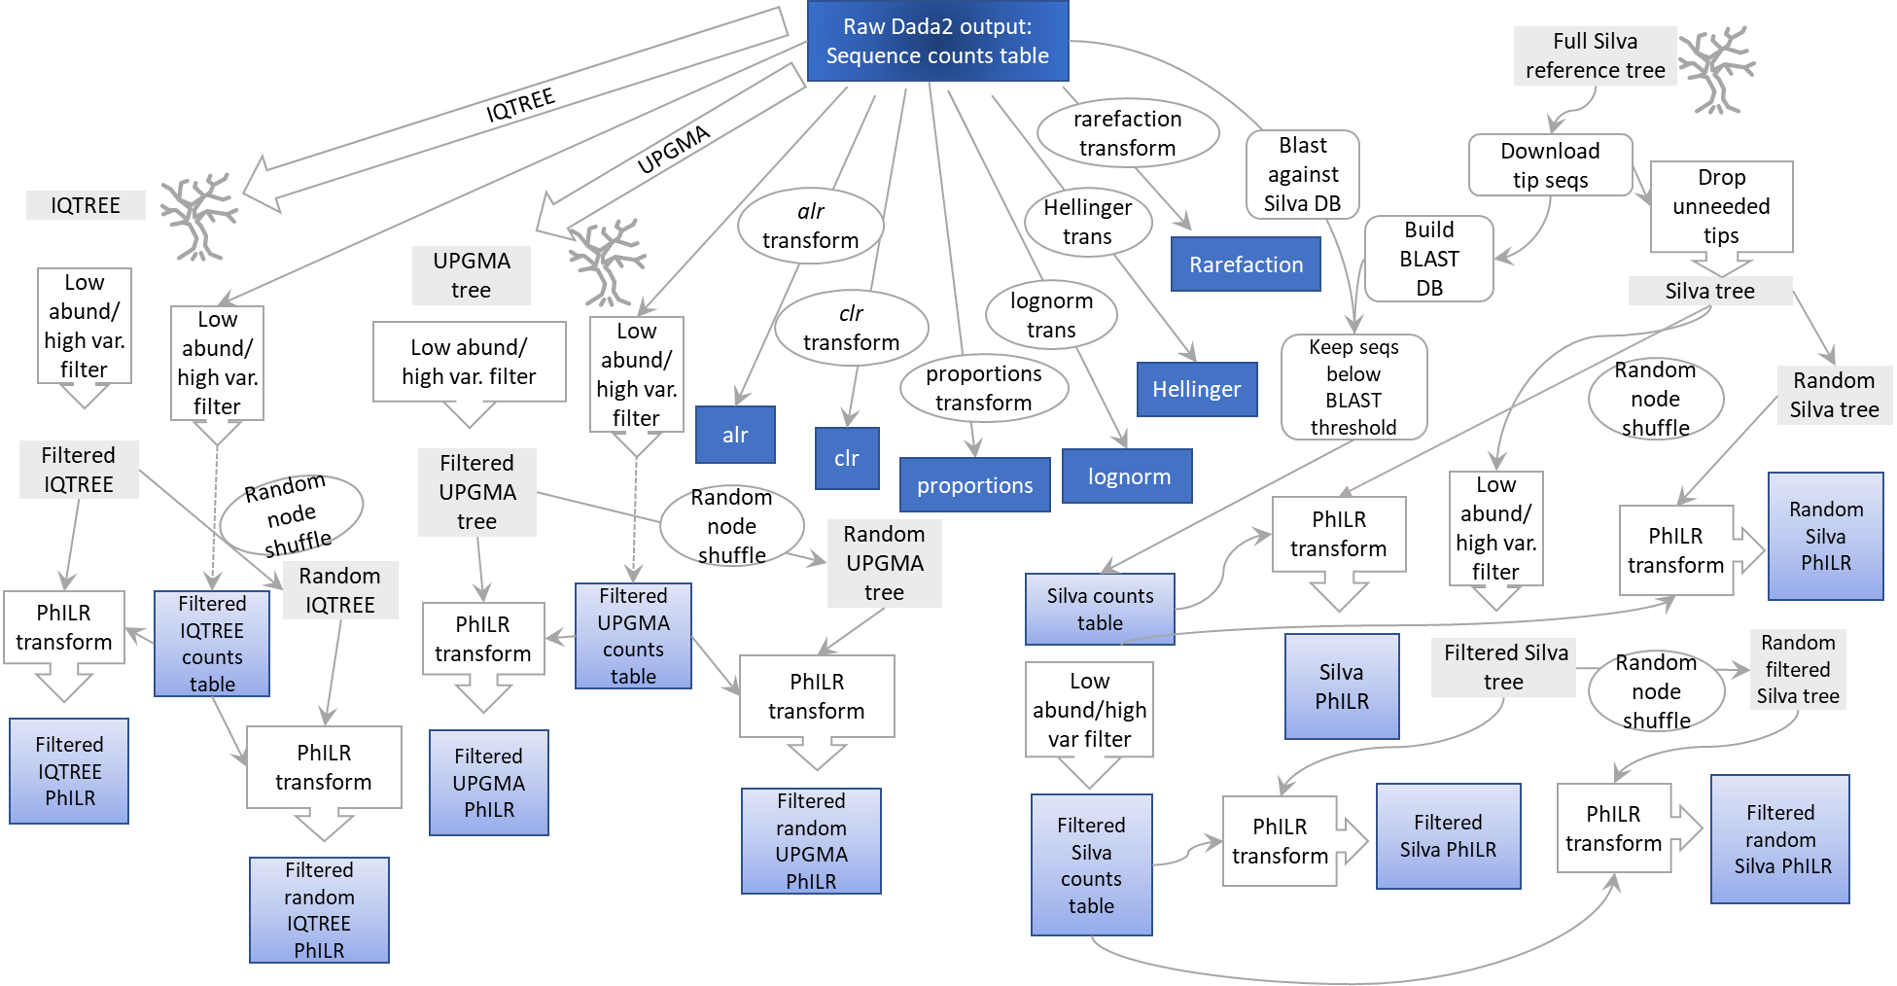

Often normalization choices matter less than you might think
Aaron Yerke
https://www.researchsquare.com/article/rs-2733639/v1
(and in revision microbiome)

Slide 19
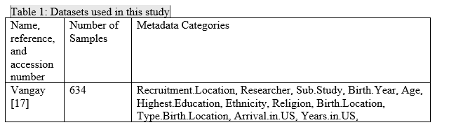
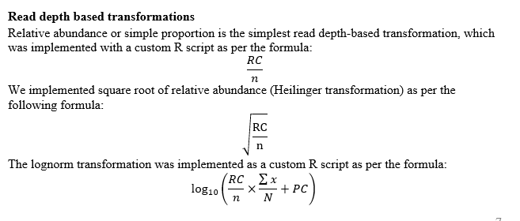
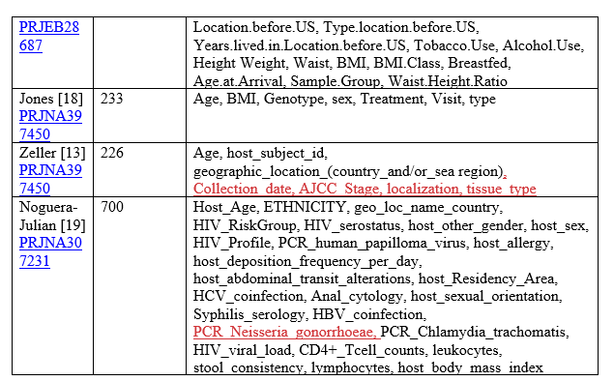
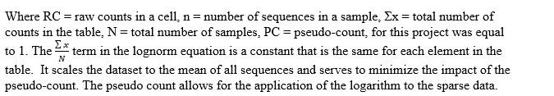

Our study ran different normalization schemes over 65 metadata variables
Daisy Brumit
Aaron Yerke
https://www.researchsquare.com/article/rs-2733639/v1
(and in revision microbiome)

Slide 20
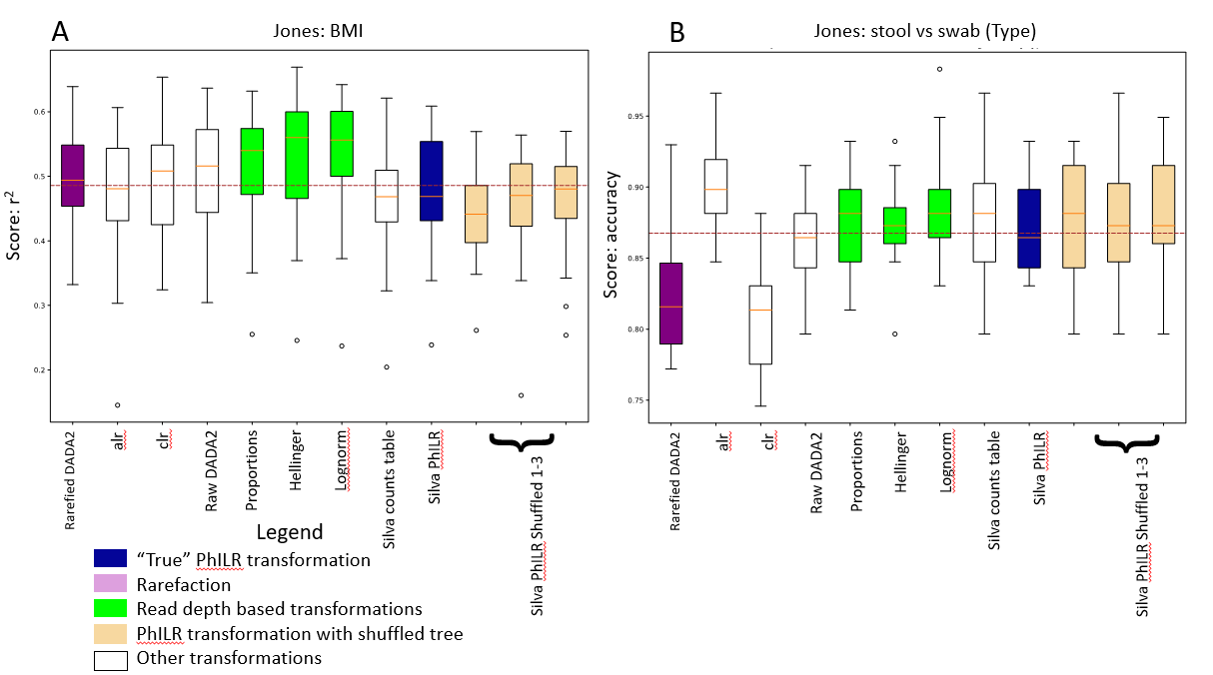
Algorithms that use “naïve” proportions have a slight edge as a Random Forest input normalization
https://www.researchsquare.com/article/rs-2733639/v1
(and in revision microbiome)

Slide 21
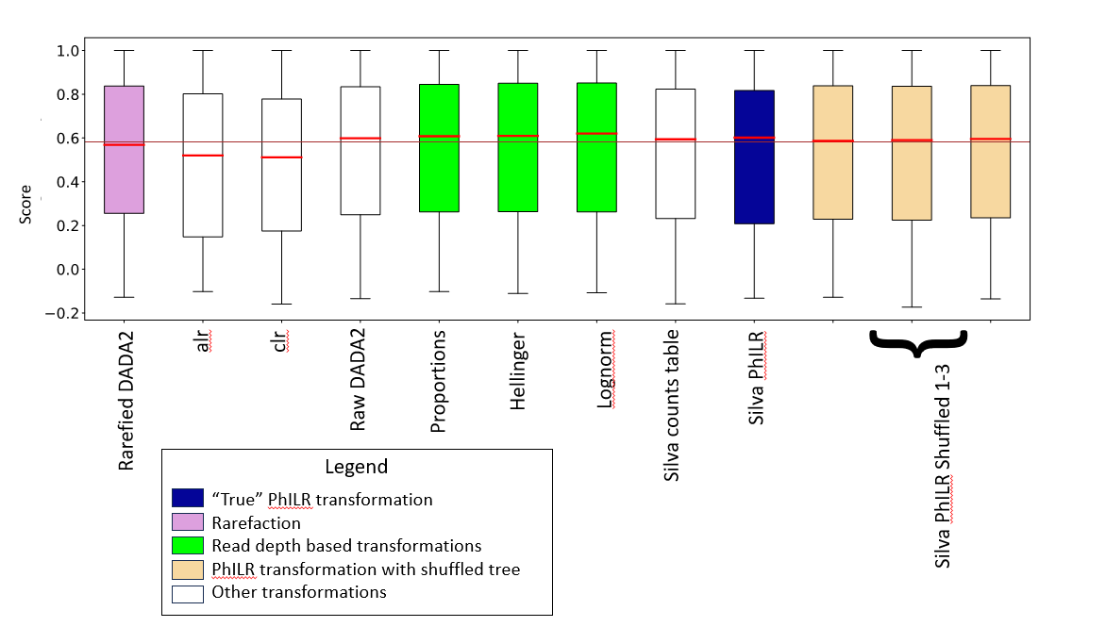
Algorithms that use “naïve” proportions have a slight edge as a Random Forest input normalization
https://www.researchsquare.com/article/rs-2733639/v1
(and in revision microbiome)

Slide 22
How do we measure and think about richness?
How do we distinguish rare mis-classifications from low abundance taxa?
Is “everything everywhere”?
A common problem in bioinformatics
You detect a ASV (sequence variant) in a 16S sequence dataset.
You detect a taxa as being present in a metagenomic WGS sequence dataset
What is the probability that that sequence variant is really there “biologically”
and does not reflect sequencing (or some other kind of) error

Slide 23
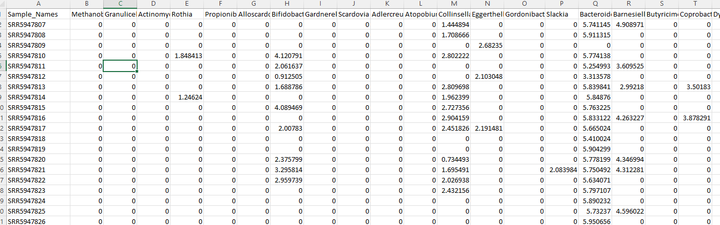
How we view prevalence and richness is very algorithm and method dependent
Metaphlan tends to produce very sparse spreadsheets with a few dominant taxa and lots of zeros…

Slide 24
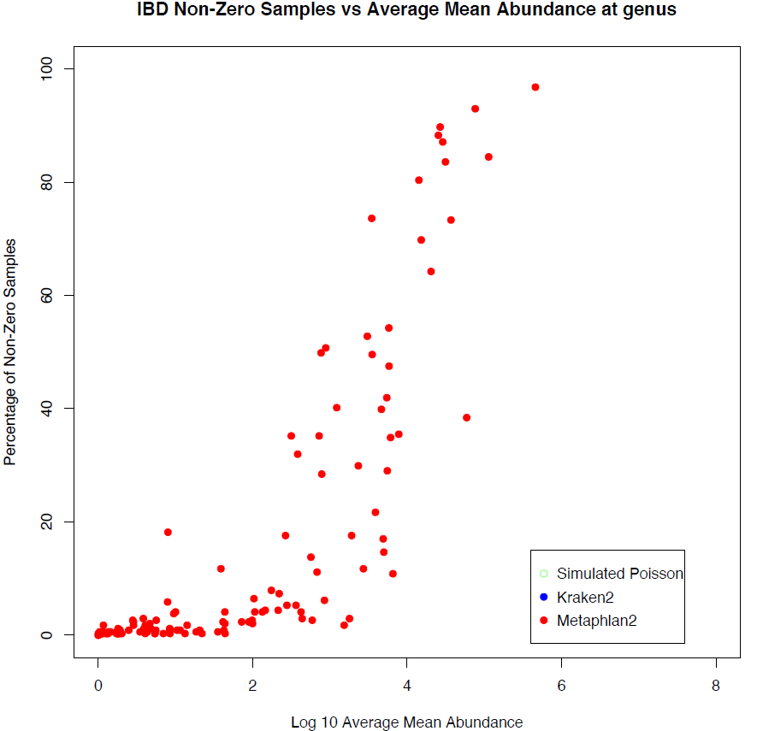
How we view prevalence and richness is very algorithm and method dependent
100
80
60
Percent of non-zero samples
40
20
0
0
2
4
6
8
Log 10 ( abundance )

Slide 25
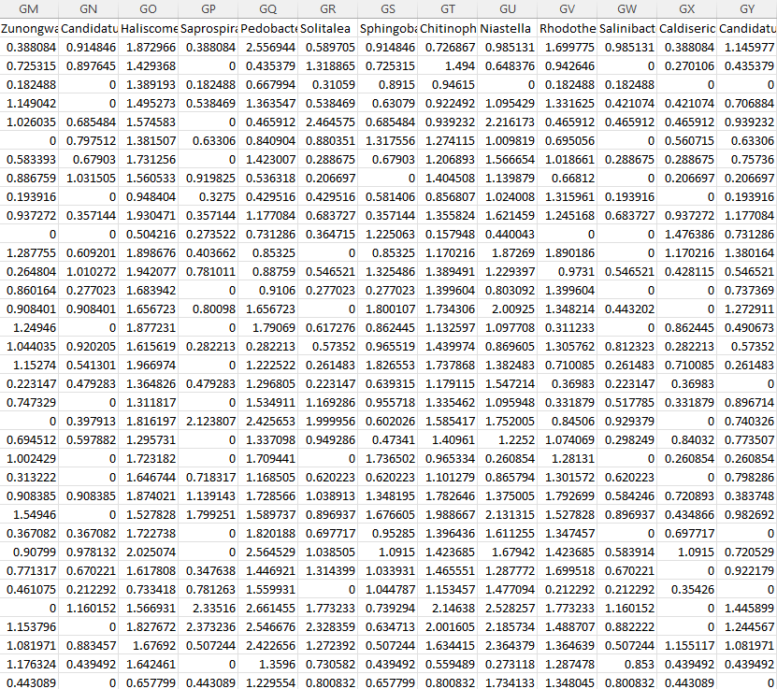
Kraken gives us a much less sparse view of the world…

Slide 26
How we view prevalence and richness is very algorithm and method dependent
100
80
60
Percent of non-zero samples
40
20
0
0
2
4
6
8
Log 10 ( abundance )
Notes:
`

Slide 27
We seek a null model that is unlikely to be explained by biology
100
80
60
Percent of non-zero samples
40
20
0
0
2
4
6
8
Log 10 ( abundance )

Slide 28
Our simplest possible model for classification: “Binomial” or “Poisson” models
You have a very (infinitely) large vat of perfectly mixed ping-pong balls
We model a sequence classification event
(for example, labeling a read represents a sequence variant)
as the probability of randomly drawing red balls from a set of sequences
N – the total number of sequences in a sample (the red balls + the white balls observed)
p – the fraction of all balls in the vat that belong to a variant
If N is large and p is small we say this is a Poisson process.
We draw a 1,000 ping pong balls (sequences) with a “true”
relative abundance of 0.1%, we would expect 1 red ping pong balls.

Slide 29
If N is large and p is small we say this is a Poisson process.
We draw a 1,000 ping pong balls (sequences) with a “true”
relative abundance of 0.1%, we would expect 1 red ping pong balls.
We can produce our expectation under such a null model very easily in a language such as R

Slide 30
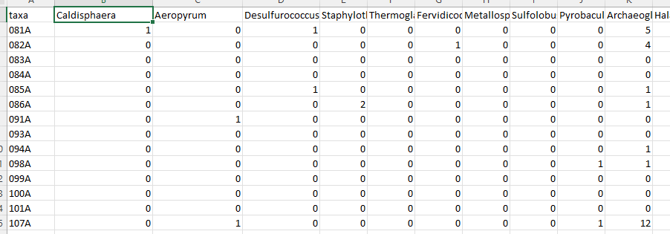
We can generate an entire “simulated” dataset under the Poisson null
Taxa
Samples
Each cell counts how many “red balls” (that taxa) from all the balls in the sample.

Slide 31
Features of a Poisson null model:
No biology (constant background error rate irrespective of sample type of phenotype)
Mean = variance

Slide 32
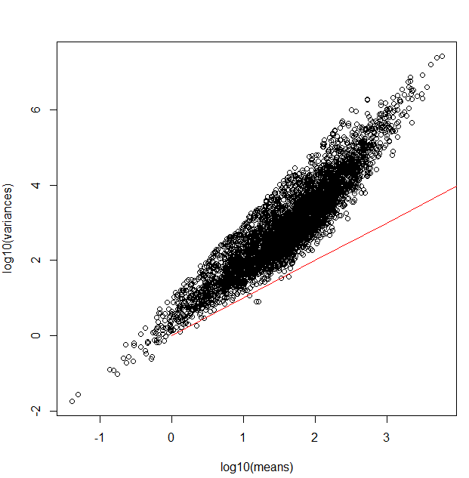
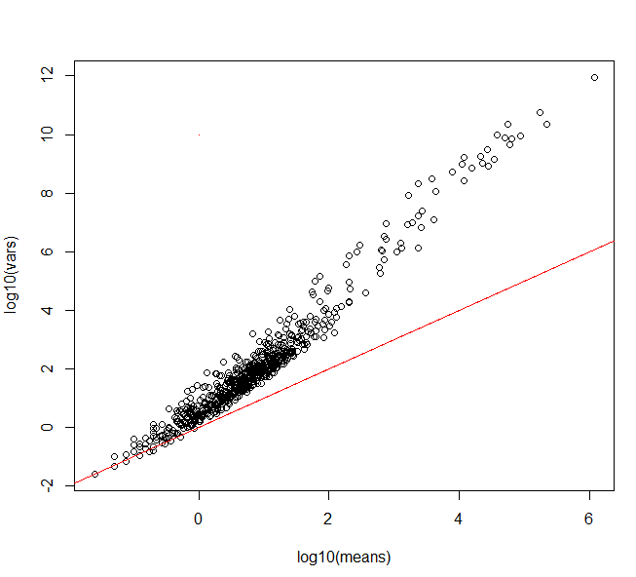
Poisson processes are reliably inadequate for modeling counts tables in genomics experiments
RNA- seq dataset
WGS dataset (through Kraken)
Log10 (variance)
Log10 (variance)
Independent draws across
samples with a constant
relative abundance
Log10 (mean)
Log10 (mean)

Slide 33
Poisson processes are reliably inadequate for modeling counts tables in genomics experiments
RNA- seq dataset
WGS dataset (through Kraken)
Log10 (variance)
Log10 (variance)
Independent draws across
samples with a constant
relative abundance
Log10 (mean)
Log10 (mean)

Slide 34
Poisson processes are reliably inadequate for modeling counts tables in genomics experiments
RNA- seq dataset
WGS dataset (through Kraken)
Log10 (variance)
Log10 (variance)
Independent draws across
samples with a constant
relative abundance
Log10 (mean)
Log10 (mean)

Slide 35
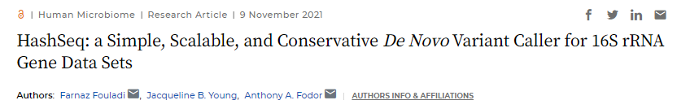


Poisson processes can be surprisingly useful in describing accumulation (richness) of sequence variants
Jack Young
Farnaz Fouladi

Slide 36
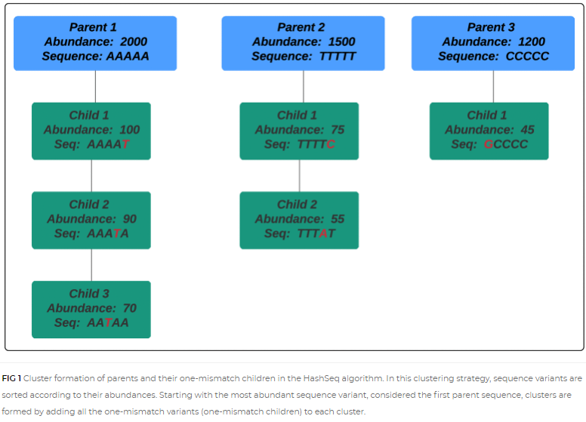
Identify all unique 16S sequences in a dataset.
Sort by abundance – find children (“single mismatch”) variants
https://journals.asm.org/doi/full/10.1128/mSystems.00697-21

Slide 37
Richness is well described across datasets by a simple Poisson process with a constant error rate

Slide 38
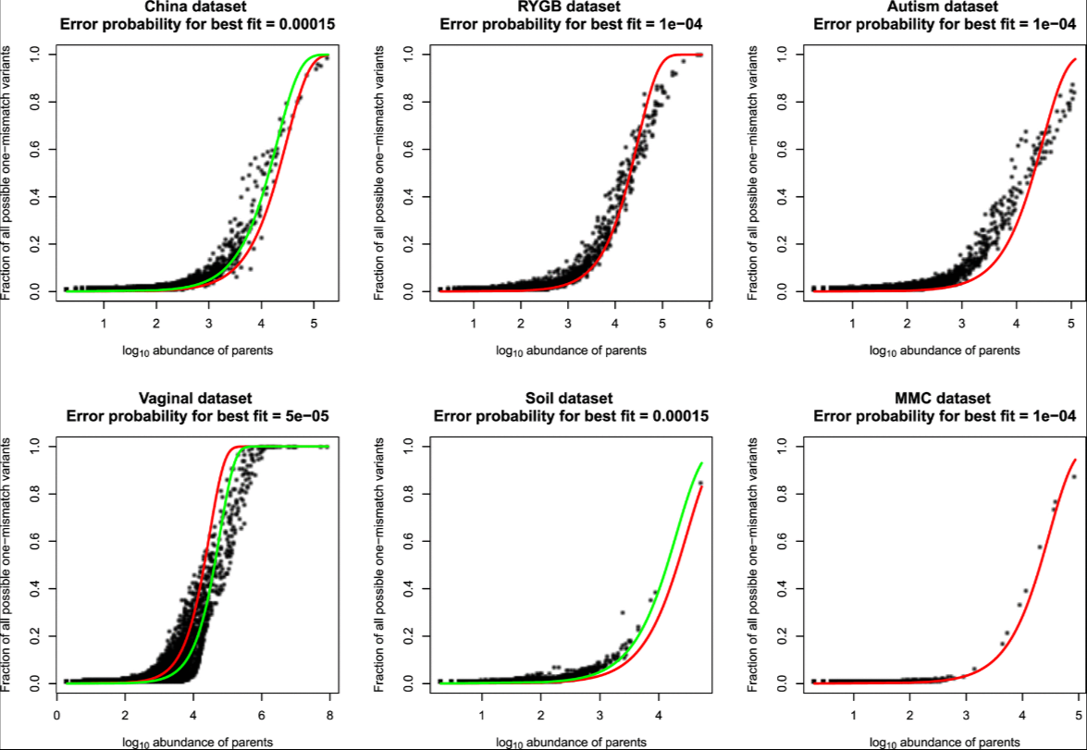
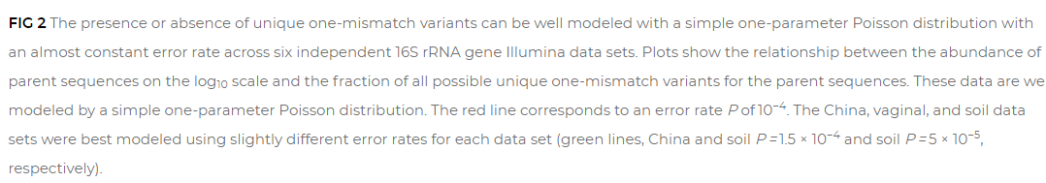
Richness is well described across datasets by a simple Poisson process with a constant error rate
Constant error rate
Best error rate
for that data set

Slide 39
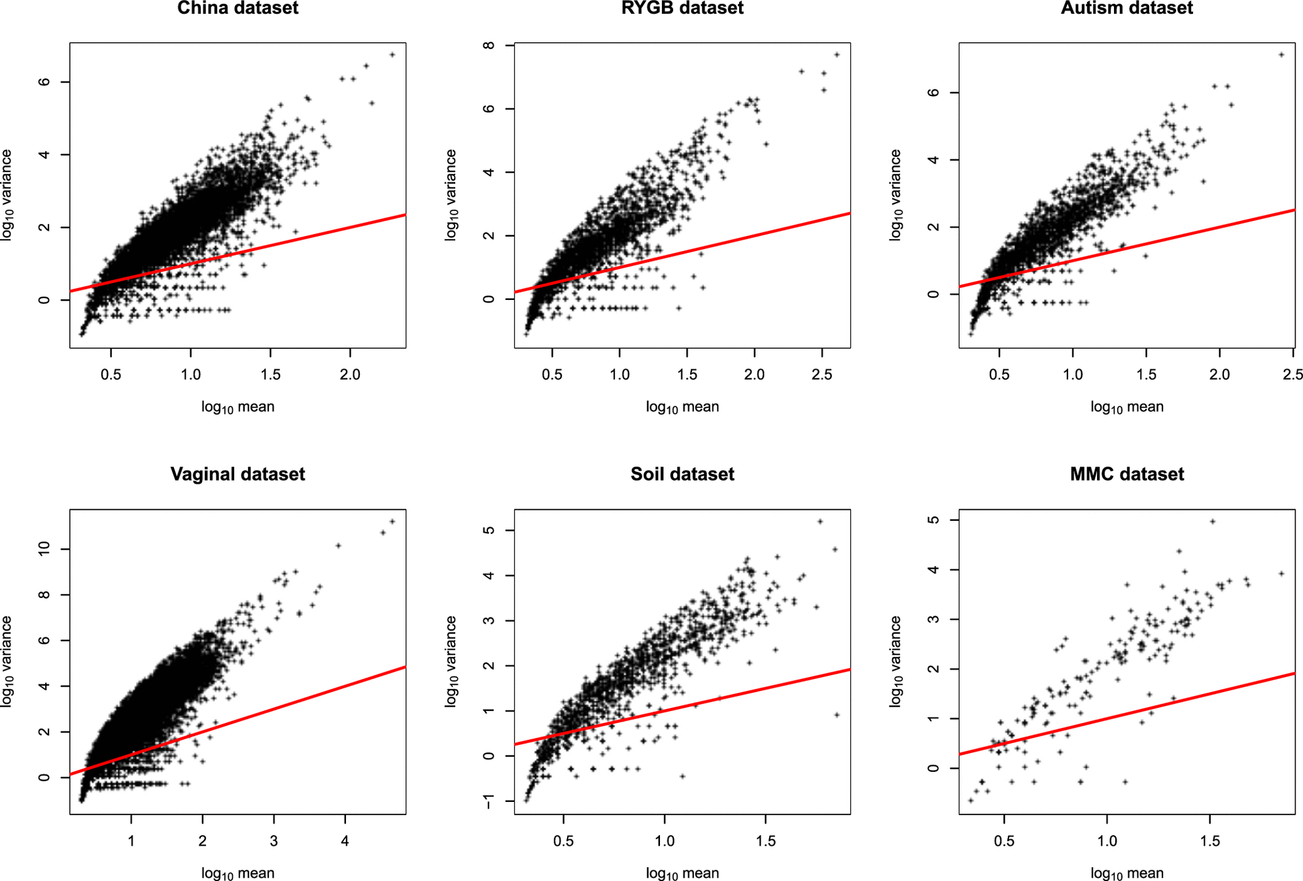
Abundance (as usual) is not well fit by Poisson assumptions

Slide 40
Richness is well described across datasets by a simple Poisson process with a constant error rate
Abundance (as usual) is not well fit by Poisson assumptions
One hypothesis:
In 16S experiments, initial errors accumulate by taq sequencing error (a Poisson process)
The final abundance is dependent on PCR amplification (not a Poisson process)

Slide 41
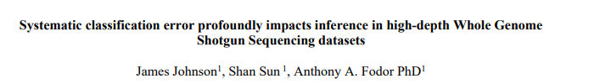

Surprisingly, Poisson algorithms can also be of utility in shotgun sequencing datasets
James Johnson
Shan Sun
Bioarchive (and unpublished!)
https://www.biorxiv.org/content/10.1101/2022.04.04.487034v2.abstract

Slide 42
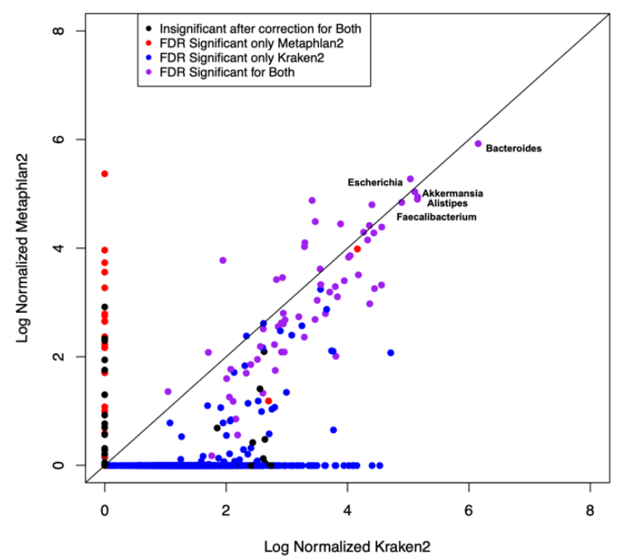
Kraken and Metaphlan agree on high-abundance taxa but not on low-abundance taxa
Kraken finds not only more taxa but more taxa significantly associated with metadata
Inference is case/control
For IBD at a 5% FDR threshold
Log 10 (mean Metaphlan 2)
Log 10 (mean Kraken 2)

Slide 43
Can we evaluate the algorithms even though we don’t know the “correct” answer…
Examine the correlation structure of predictions
Sort all taxa by abundance
1st most abundance – Bacteroides
2nd most abundance – Escherichia
3rd most abundant – Akkermansia
4th most abundant – Alistipes
…
…
For each taxa, report the highest correlation coefficient among all more abundant taxa
So for the 2nd most abundant, this will be the correlation with the 1st most abundance
For the 3rd most abundant, this will be the max( cor(3rd, 2nd), cor(3rd , 1st))
For the 4th most abundance, this be the max( cor(4th, 1st), cor(4th, 2nd), cor(4th, 3rd) )
And so forth…

Slide 44
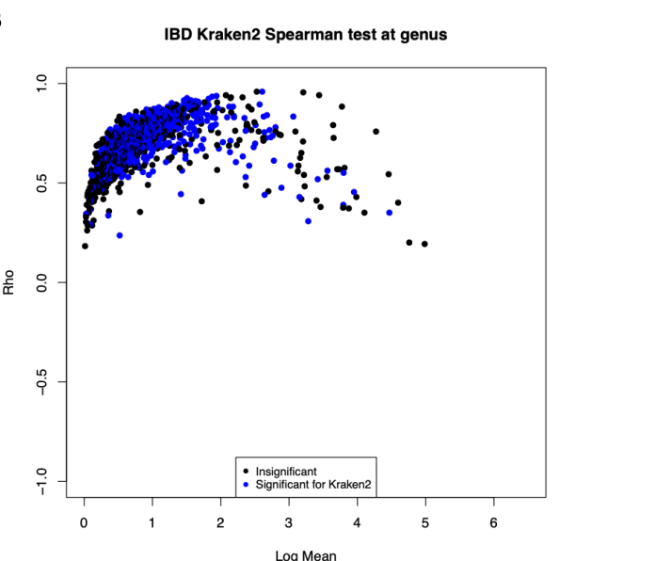
Many of taxa for Kraken are highly correlated with a more abundant “parent” taxa
Rho
Log 10 (mean Kraken 2)

Slide 45
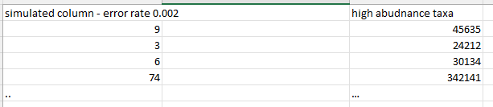
We can model this behavior with a simple Poisson-based procedure with a small # of free parameters
Assume the top 10 taxa are “real”.
Simulate the rest of the dataset as Poisson based sampling error:
for each “simulated” taxa
randomly choose one of
randomly choose an error rate over some range (e.g. 0 < error <= 0.002 )
sum(rpois(45635, lambda = .0002))

Slide 46
We can model this behavior with a simple Poisson-based procedure with a small # of free parameters
Assume the top 10 taxa are “real”.
Simulate the rest of the dataset as Poisson based sampling error:
for each “simulated” taxa
randomly choose one of
randomly choose an error rate over some range (e.g. 0 < error <= 0.002 )
sum(rpois(24212, lambda = .0002))

Slide 47
We can model this behavior with a simple Poisson-based procedure with a small # of free parameters
Assume the top 10 taxa are “real”.
Simulate the rest of the dataset as Poisson based sampling error:
for each “simulated” taxa
randomly choose one of
randomly choose an error rate over some range (e.g. 0 < error <= 0.002 )
sum(rpois(30134, lambda = .0002))

Slide 48
We can model this behavior with a simple Poisson-based procedure with a small # of free parameters
Assume the top 10 taxa are “real”.
Simulate the rest of the dataset as Poisson based sampling error:
for each “simulated” taxa
randomly choose one of
randomly choose an error rate over some range (e.g. 0 < error <= 0.002 )
sum(rpois(342141, lambda = .0002))

Slide 49
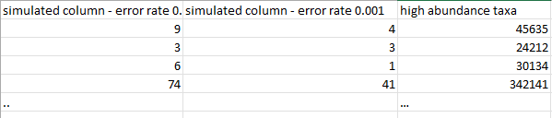
We can model this behavior with a simple Poisson-based procedure with a small # of free parameters
Assume the top 10 taxa are “real”.
Simulate the rest of the dataset as Poisson based sampling error:
for each “simulated” taxa
randomly choose one of
randomly choose an error rate over some range (e.g. 0 < error <= 0.002 )
sum(rpois(45635, lambda = .0001))

Slide 50
We can model this behavior with a simple Poisson-based procedure with a small # of free parameters
Assume the top 10 taxa are “real”.
Simulate the rest of the dataset as Poisson based sampling error:
for each “simulated” taxa
randomly choose one of
randomly choose an error rate over some range (e.g. 0 < error <= 0.002 )
sum(rpois(24212, lambda = .0001))

Slide 51
We can model this behavior with a simple Poisson-based procedure with a small # of free parameters
Assume the top 10 taxa are “real”.
Simulate the rest of the dataset as Poisson based sampling error:
for each “simulated” taxa
randomly choose one of
randomly choose an error rate over some range (e.g. 0 < error <= 0.002 )
sum(rpois(30134, lambda = .0001))

Slide 52
We can model this behavior with a simple Poisson-based procedure with a small # of free parameters
Assume the top 10 taxa are “real”.
Simulate the rest of the dataset as Poisson based sampling error:
for each “simulated” taxa
randomly choose one of
randomly choose an error rate over some range (e.g. 0 < error <= 0.002 )
sum(rpois(342141, lambda = .0001))
In this way we simulate the entire dataset assuming that everything except the
most abundant taxa is Poisson-based classification error of the most abundant taxa

Slide 53
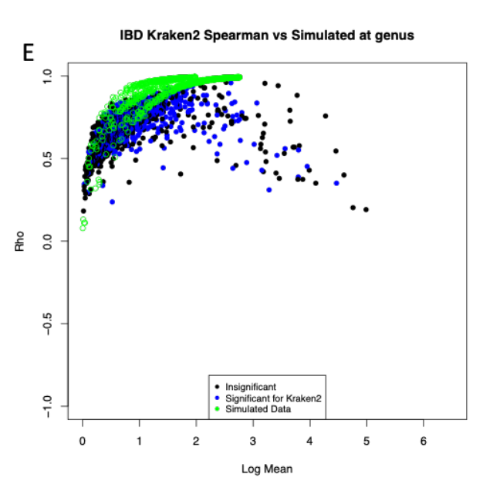
Somewhat remarkably, this simple model captures much of the behavior of low-abundance Kraken taxa
Rho
Log 10 (mean Kraken 2)

Slide 54
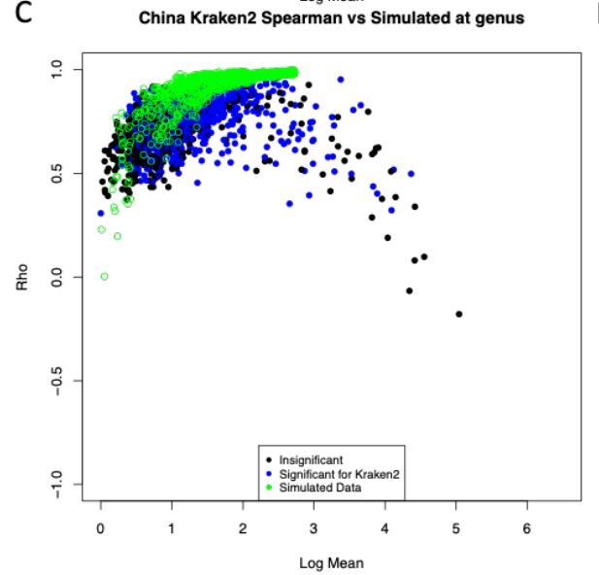


A constant error rate fits three of four datasets very well

Slide 55
We can explain much of the prevalence relationship from Kraken with our Poisson model
(alas, with a different background error rate….)
100
80
60
Percent of non-zero samples
40
20
0
0
2
4
6
8
Log 10 ( abundance )

Slide 56
Mis-classification events from k-mer classifiers of WGS can be well modeled
with a Poisson distribution with no biology in the null model
Spurious correlations can be problematic for network analysis
Low abundance taxa with high correlations to high abundance taxa should be independently confirmed
as being actually present and not “phantom”
Filtering thresholds for WGS datasets should be set from abundance (not prevalence!)
Mis-classification events become more likely as sequencing depth and database density increase!
Error models may allow us to capture background expectations and evaluate null hypotheses
that a given observation of a taxa can be explained by background error rate calculations…
We have such a model for 16S ASVs and are working towards that in WGS

Slide 57







Slide 60

Kraken and Metaphlan agree on high-abundance taxa but not on low-abundance taxa
Kraken finds not only more taxa but more taxa significantly associated with metadata

